Slide 1
Regression

Slide 2
The term regression is used when you try to find the relationship between variables.
In Machine Learning, and in statistical modeling, that relationship is used to predict the outcome of future events.

Slide 3
What Is Linear Regression?
Linear regression is an algorithm that provides a linear relationship between an independent variable and a dependent variable to predict the outcome of future events.
It is a statistical method used in data science and machine learning for predictive analysis.
The independent variable is also the predictor or explanatory variable that remains unchanged due to the change in other variables.
However, the dependent variable changes with fluctuations in the independent variable.
The regression model predicts the value of the dependent variable, which is the response or outcome variable being analyzed or studied.

Slide 4
Thus, linear regression is a supervised learning algorithm that simulates a mathematical relationship between variables and makes predictions for continuous or numeric variables such as sales, salary, age, product price, etc.
This analysis method is advantageous when at least two variables are available in the data, as observed in stock market forecasting, portfolio management, scientific analysis, etc.

Slide 5
Examples
1. Let us say we want to have a system that can predict the price of a used car. Inputs are thecar attributes âA˘T brand, year, engine capacity, mileage, and other information â ˇ A˘T that we ˇ
believe affect a car’s worth. The output is the price of the car.
2. Consider the navigation of a mobile robot, say an autonomous car. The output is the angle by
which the steering wheel should be turned at each time, to advance without hitting obstacles
and deviating from the route. Inputs are provided by sensors on the car like a video camera,
GPS, and so forth.
3. In finance, the capital asset pricing model uses regression for analyzing and quantifying the
systematic risk of an investment.
4. In economics, regression is the predominant empirical tool. For example, it is used to predict
consumption spending, inventory investment, purchases of a country’s exports, spending on
imports, labor demand, and labor supply

Slide 6
Types of linear regression
The different regression models are defined based on type of functions used to represent the relation between the dependent variable y and the independent variables.
Simple Linear Regression
This is the simplest form of linear regression, and it involves only one independent variable and one dependent variable. The equation for simple linear regression is: y=β0+β1Xy=β0​+β1​X where:
Y is the dependent variable
X is the independent variable
β0 is the intercept
β1 is the slope
Example: The relationship between pollution levels and rising temperatures.
The value of the dependent variable is based on the value of the independent variable.

Slide 7
Multiple Linear Regression
This involves more than one independent variable and one dependent variable. The equation for multiple linear regression is: y=β0+β1X1+β2X2+………βnXn
where:
Y is the dependent variable
X1, X2, …, Xn are the independent variables
β0 is the intercept
β1, β2, …, βn are the slopes
Example: Consider the task of calculating blood pressure. In this case, height, weight, and amount of exercise can be considered independent variables. Here, we can use multiple linear regression to analyze the relationship between the three independent variables and one dependent variable, as all the variables considered are quantitative.

Slide 8
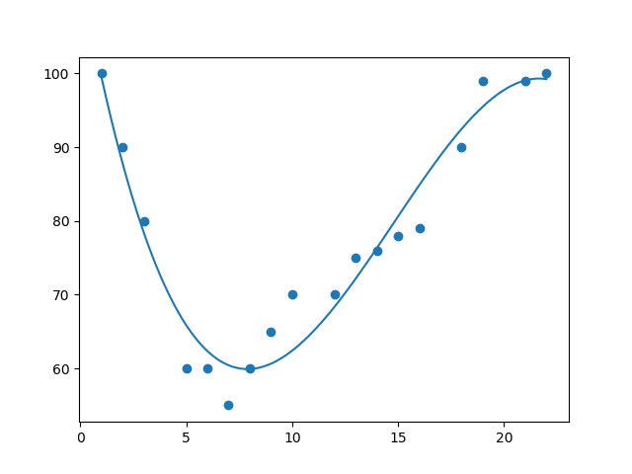
Polynomial Regression
If your data points clearly will not fit a linear regression (a straight line through all data points), it might be ideal for polynomial regression.
Polynomial regression, like linear regression, uses the relationship between the variables x and y to find the best way to draw a line through the data points.

Slide 9

The Polynomial Regression equation is given below:
It is also called the special case of Multiple Linear Regression in ML. Because we add some polynomial terms to the Multiple Linear regression equation to convert it into Polynomial Regression.
It is a linear model with some modification in order to increase the accuracy.
The dataset used in Polynomial regression for training is of non-linear nature.
It makes use of a linear regression model to fit the complicated and non-linear functions and datasets.
Hence, "In Polynomial regression, the original features are converted into Polynomial features of required degree (2,3,..,n) and then modeled using a linear model."

Slide 10
Need for Polynomial Regression:
The need of Polynomial Regression in ML can be understood in the below points:
If we apply a linear model on a linear dataset, then it provides us a good result as we have seen in Simple Linear Regression, but if we apply the same model without any modification on a non-linear dataset, then it will produce a drastic output. Due to which loss function will increase, the error rate will be high, and accuracy will be decreased.
So for such cases, where data points are arranged in a non-linear fashion, we need the Polynomial Regression model. We can understand it in a better way using the below comparison diagram of the linear dataset and non-linear dataset.

Slide 11
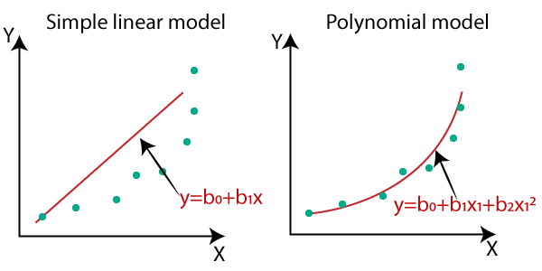
In the above image, we have taken a dataset which is arranged non-linearly. So if we try to cover it with a linear model, then we can clearly see that it hardly covers any data point. On the other hand, a curve is suitable to cover most of the data points, which is of the Polynomial model.
Hence, if the datasets are arranged in a non-linear fashion, then we should use the Polynomial Regression model instead of Simple Linear Regression.

Slide 12
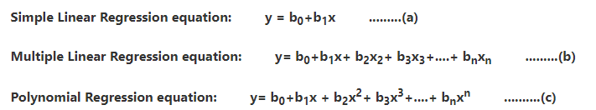
When we compare the above three equations, we can clearly see that all three equations are Polynomial equations but differ by the degree of variables.
The Simple and Multiple Linear equations are also Polynomial equations with a single degree, and the Polynomial regression equation is Linear equation with the nth degree.
So if we add a degree to our linear equations, then it will be converted into Polynomial Linear equations.

Slide 13
Linear Regression
If we have data of college student CGPA and LPA salary after placement of the student as input feature..
That means it should predict salary of student if we will provide his/her CGPA.
How to approach this problem.
Suppose I have no CGPA and if someone ask me that what will be the package of students.
Then we will simply take average of package of students we will tell the answer. This is very bad guess.
But if we have data, then we will plot this data

Slide 14
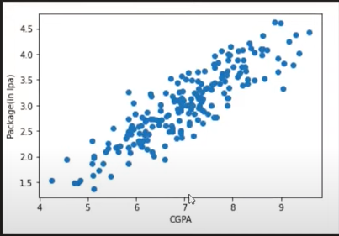
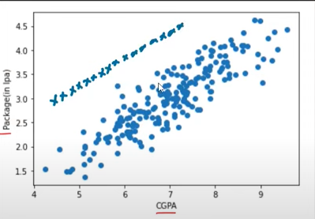
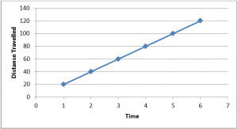
Data is sort of linear not completely linear. A completely linear data looks like this

Slide 15
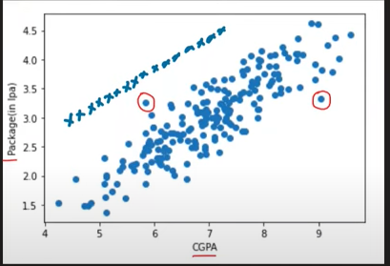
This is a real world data with some excepts as seen in graph.
Those errors which cant be quantified are called
Stochastic errors.
If the data is completely linear, we will draw line and
write line equation
y=mx + b where x is cgpa and y is salary
But our data is sort of linear
So we will draw a line called Best fit line
Our primary objective while using linear regression is to locate the best-fit line, which is line that will pass closest to all the data points in the data set. which implies that the error between the predicted and actual values should be kept to a minimum. There will be the least error in the best-fit line.
The best Fit Line equation provides a straight line that represents the relationship between the dependent and independent variables. The slope of the line indicates how much the dependent variable changes for a unit change in the independent variable(s).

Slide 16
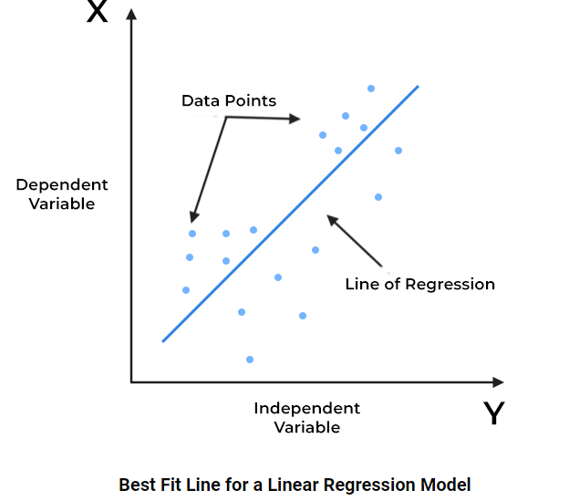
In the above figure,
X-axis = Independent variable
Y-axis = Output / dependent variable
Line of regression = Best fit line for a model
Here, a line is plotted for the given data points that suitably fit all the issues. Hence, it is called the ‘best fit line.’ The goal of the linear regression algorithm is to find this best fit line seen in the above figure.
It is called best fit line because it is doing minimum error.

Slide 17
So linear regression will draw a line on sort of linear data which pass closest to all the data points.
That means it will find that value of m(slope) and b (intercept) which will do minimum error on the data points

Slide 18
Human intution
So mathematically we understood that linear regression is drawing a best fit line by finding the value of m and b in straight line equation
Y= mx +c
Package= m * CGPA +B
Here m can be said as weights that means the way m value will increase ,the impact of CGPA on package will also increase.
To understand B lets put b to 0
Y= mx
Lets say we have x as experience in years and y is package ,so as per above equation,if experience is 0 then package will also be 0 which is not correct

Slide 19
To find value of m and b we can have 2 methods
Closed form solution where we can use direct mathematical formulas to find value called OLS (Ordinary Least Square) and Scikit learn library also use this method in its linear regression class.
Non Closed form solution where we have to use approximations using integration and differentiation. The technique we use here is called Gradient Descent.
When we work on higher dimensions then it is difficult to do calculations by using formula, so we use approximations.
In sgdregressor class ,gradient descent is implemented.

Slide 20

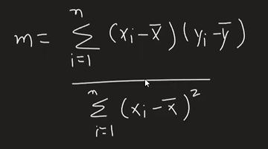
We can calculate b using formula
Where y is package and x is cgpa
X bar and Y bar are mean values of X and Y
Xi and Yi are current row ‘s CGPA and Package value
So after calculating m we will calculate b
So linear regression class of scikit learn is using these formulas and giving answers

Slide 21
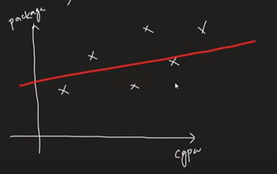
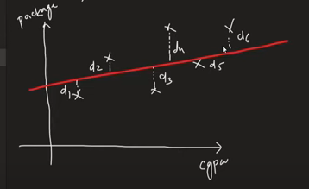

How these formulas are coming
Lets assume that our data points are sort of linear and we have to draw a best fit line on them i.e we have to find values of m and b
We know that best fit line is that line which is having minimum distance between point and line.
If distance is d1 and d2 and so on then total error will be
d1+d2+d3……dn

Slide 22


We have squared as the points are below and above the line so we have to squared them.
We cannot take modulus because we have to penalize the points which are outliers .Also at one point we have to differentiate the expression and we cannot do this for modulus expression as it passes through 0.
While square function can be differentiable at any point

Slide 23
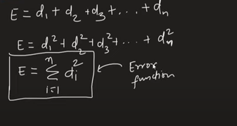
In machine learning language ,it is also called LOSS FUNCTION
So earlier we were saying that we want a line segment which pass closest to all data points.
But now we can say that we need that value of m and b which minimize the value of error function.

Slide 24


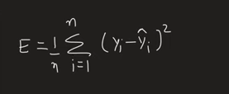
For every point d can be represented as
Where Yi is actual value and ŷi is predicted value
So total error =
Average error =
So we need to find that value of m,b for which error should be minimum.but where is m,b in this formula?

Slide 25


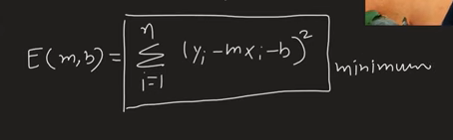
So
That means we need to find that value of m and b for which Error is minimum.

Slide 26


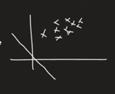


So E= f(m,b)
That means Error will be impacted both with m and b.lets see this impact separately
E=f(m) b=0 (intercept is 0 so line will pas through origin)
Here we will see the impact of moving m(slope ) on error (E)
B=0

Slide 27
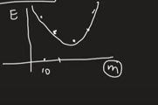
Suppose if m is 10 then E is 50,Now we have moved line so error will get reduced,if we move line more then again error will increase.
That means when we are changing m,then
E initially max then reduced and then icrease
As shown in figure

Slide 28

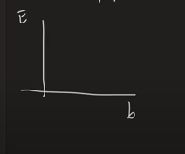
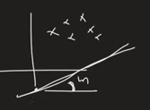
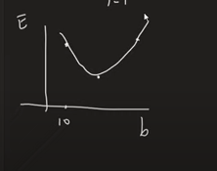
Now if m is constant(slope is 1 suppose)
Then equation will change to
Here m is constant but we are changing b,

Slide 29
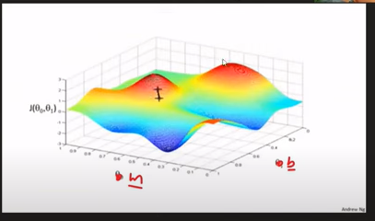
For certain value of m and b,error will be maximum and for some value it will be minimum
So we need to find that value of m and b where error value will be minimum
At minimum point,slope will be 0
And to find out slope the formula is to find minima that means find derivative and equate it to 0

Slide 30
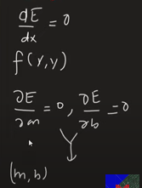

Slide 31
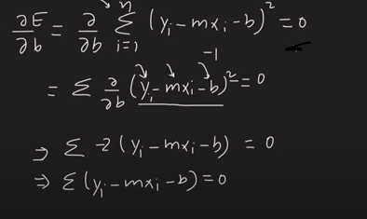

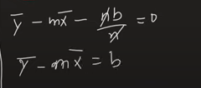


Slide 32
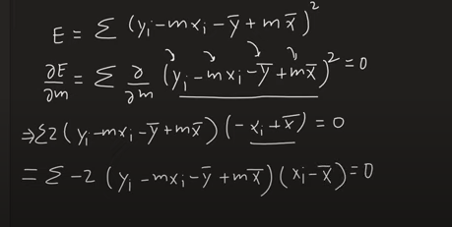
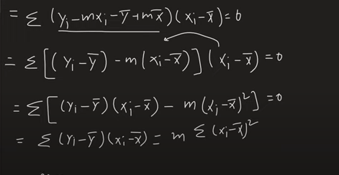
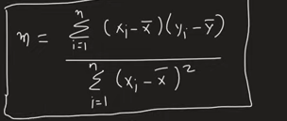
Divide by -2 on both sides

Slide 33
Key benefits of linear regression
1. Easy implementation
The linear regression model is computationally simple to implement as it does not demand a lot of engineering overheads, neither before the model launch nor during its maintenance.
2. Interpretability
Unlike other deep learning models (neural networks), linear regression is relatively straightforward. As a result, this algorithm stands ahead of black-box models that fall short in justifying which input variable causes the output variable to change.
3. Scalability
Linear regression is not computationally heavy and, therefore, fits well in cases where scaling is essential. For example, the model can scale well regarding increased data volume (big data).
4. Optimal for online settings
The ease of computation of these algorithms allows them to be used in online settings. The model can be trained and retrained with each new example to generate predictions in real-time, unlike the neural networks or support vector machines that are computationally heavy and require plenty of computing resources and substantial waiting time to retrain on a new dataset.

Slide 34
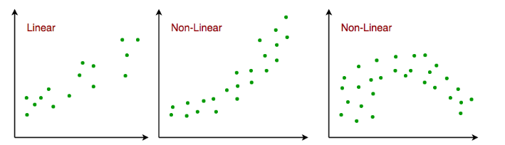
Assumptions of simple linear regression
Linear regression is a powerful tool for understanding and predicting the behavior of a variable, however, it needs to meet a few conditions in order to be accurate and dependable solutions.
Linearity: The independent and dependent variables have a linear relationship with one another. This implies that changes in the dependent variable follow those in the independent variable(s) in a linear fashion. This means that there should be a straight line that can be drawn through the data points. If the relationship is not linear, then linear regression will not be an accurate model.

Slide 35
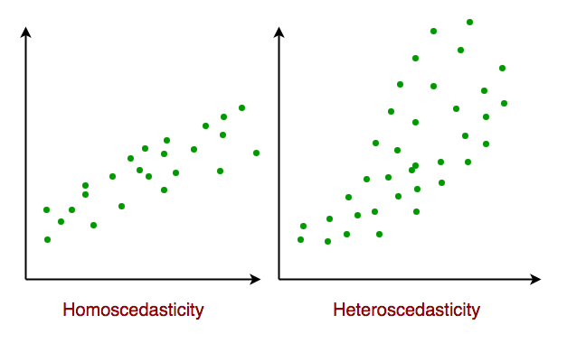
Independence: The observations in the dataset are independent of each other. This means that the value of the dependent variable for one observation does not depend on the value of the dependent variable for another observation. If the observations are not independent, then linear regression will not be an accurate model.
Homoscedasticity: Across all levels of the independent variable(s), the variance of the errors is constant. This indicates that the amount of the independent variable(s) has no impact on the variance of the errors. If the variance of the residuals is not constant, then linear regression will not be an accurate model.

Slide 36
Normality: The residuals should be normally distributed. This means that the residuals should follow a bell-shaped curve. If the residuals are not normally distributed, then linear regression will not be an accurate model.

Slide 37
Evaluation Metrics for Linear Regression
A variety of evaluation measures can be used to determine the strength of any linear regression model. These assessment metrics often give an indication of how well the model is producing the observed outputs.

Slide 38
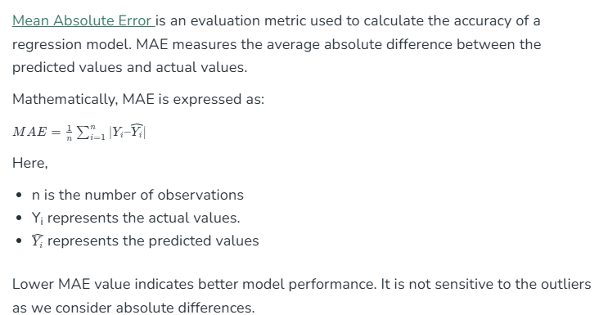
MEAN ABSOLUTE ERROR

Slide 39

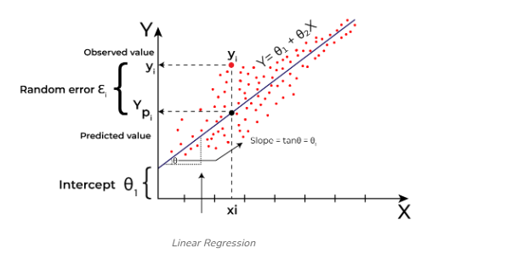
Total absolute error=
For mean absolute error ,we will divide it by n

Slide 40
Advantage
The number we get here is mean absolute error is loss,which we should get as less as possible.
This number is exactly in units of y that means if x is CGPA and Y is package in LPA,so MAE here will also come in LPA(unit of y).So prediction becomes very easy.Like if MAE is coming 1.5 that means it is 1.5 LPA and we can think of reducing it further.
It is robust for outliers.
DISADVANTAGES
Here modulus function we are using and graph of modulus function is not differentiable at 0.So MSE come

Slide 41
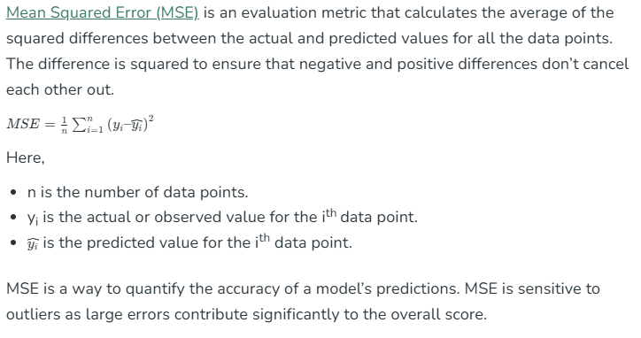
Mean Squared Error (MAE)

Slide 42
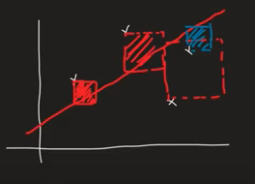
Geometrically if we want to see what MSE is showing
So it is trying to add all these squares area and trying to minimize it.

Slide 43
Advantage
We can use it as loss function as it is differentiable
Disadvantage
When the number comes then lets say if x is cgpa and y is package is LPA then MSE will be in LPA square
It penalize outliers a lot so not robust for outliers

Slide 44

Root Mean Squared Error (RMSE)
The square root of the residuals’ variance is the Root Mean Squared Error. It describes how well the observed data points match the expected values, or the model’s absolute fit to the data.
MSE,MAE depends on context like 1.5 lpa error is fine but 1.5 degree error in self driven car is not acceptable

Slide 45
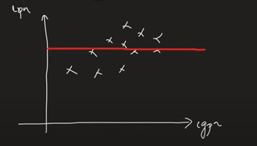
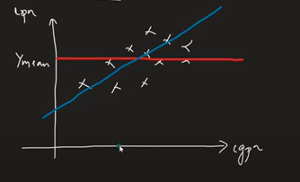
R2 score
Lets suppose we have dataset of CGPA and package
Suppose we have cgpa and we have to find package,then we will use average value(mean value)
But we have CGPA and we will draw best fit line.
R2 score will tell us how good your model is as compared to your mean

Slide 46

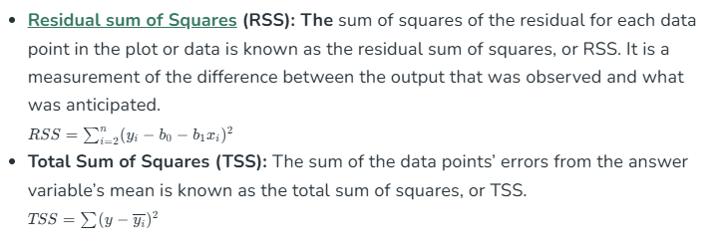
So in numerator ,it is best what we have done and denominator it is worst that can happen
R-Squared is a statistic that indicates how much variation the developed model can explain or capture. It is always in the range of 0 to 1.
In general, the better the model matches the data, the greater the R-squared number.

Slide 47
Interpretation of R2 square
If for CGPA and Package data if r2 score is 80%
It means your cgpa which is input column is able to explain 80 % of variance in the output column.
Suppose we have one more data of IQ and CGPA as input and Package as output,R2 score is 90 that means 90 % of variation in package column justification is given by CGPA and IQ column while for 20 % variation we have no justification

Slide 48
R2 score flaw
As we increase more and more columns in input columns then R2 score start increasing.
Because it is assumed that it is giving more justification in variance of output.
Bt problem comes when suppose we add one more column say temperature along with IQ and CGPA.
This column is totally irrelevant. So ideally R2 score should reduce but it will either remain constant or increase.
To solve this problem comes adjusted R2 score

Slide 49
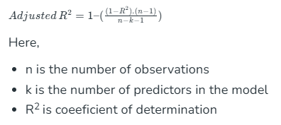
Adjusted R-squared score
Adjusted R-square accounts the number of predictors in the model and penalizes the model for including irrelevant predictors that don’t contribute significantly to explain the variance in the dependent variables.
Mathematically, adjusted R² is expressed as:
Predictor means num of inputs

Slide 50

Case 1:When we are adding a irrelevant column in input features (temperature)
Then k will increase,so denominator term will decrease.
(n-1)term in numerator will be constant
Now since the column is irrelevant so R2 score will either be same or increase slightly.
So we can assume that numerator is almost constant but as shown above that denominator term is decreased so overall term will increase
Hence 1- term =decrease
That means adjusted R2 score will be decrease

Slide 51
Adjusted R-square helps to prevent overfitting. It penalizes the model with additional predictors that do not contribute significantly to explain the variance in the dependent variable.

Slide 52
Case 2:When we are adding a relevant column in input features(IQ)
Then k will increase,so denominator term will decrease.
(n-1)term in numerator will be constant
Now since the column is relevant so R2 score will increase so (1- R2) will decrease
So we can say that numerator term will decrease speedly as compared to denominator .So overall term will decrease
Hence 1- term =increase

Slide 53
https://www.geeksforgeeks.org/ml-linear-regression/
https://www.javatpoint.com/linear-regression-in-machine-learning
https://www.spiceworks.com/tech/artificial-intelligence/articles/what-is-linear-regression/

